Slide 1
Testing JavaScript
Mack 2022

Slide 2
Introduction
Test Driven Development, or TDD for short, is a big deal in the modern development landscape. This is a concept that we introduced way back in our Fundamentals section with our JavaScript Exercises. The main idea is simply that you start working on your code by writing automated tests before writing the code that is being tested. There are tons of benefits to working like this, all of which will be discussed in the resources below.
There are many test-running systems available in JavaScript: Mocha, Jasmine, Tape and Jest to name a few. Fortunately the syntax for each one is very similar. They all have their own set of special features, but the basic syntax is almost identical, so in the end it doesn’t matter which one you use. In fact, simply picking which library to use for this curriculum has been quite tricky!
This lesson is going to center around Jest. The biggest reasons for this decision are that one of the best resources we’ve found for explaining JavaScript testing uses it and they have fantastic documentation. In the end, writing tests is less about the syntax and more about the TDD philosophy. The most important issues are knowing why we write tests and what we test rather than how.

Slide 3
Learning Outcomes
Explain the basics of TDD.
Get up and running with Jest.
Write basic tests.

Slide 4
Read
Read this short article that outlines the basic process and the benefits of TDD.
Notes:
🍐 This is a Pear Deck Web Slide.
🍐 To edit the type of question, go back to the "Ask Students a Question" in the Pear Deck sidebar.

Slide 5
Watch
Watch at least the first 3 videos of this video series about testing in JavaScript. The first video focuses heavily on the WHY, while the next two go into more depth about the process. Later videos in the series are definitely worthwhile, but the first 3 are enough to get you up and running.
Notes:
🍐 This is a Pear Deck Web Slide.
🍐 To edit the type of question, go back to the "Ask Students a Question" in the Pear Deck sidebar.

Slide 6
Jest
Read and follow the Getting Started tutorial on the main Jest website.
Notes:
🍐 This is a Pear Deck Web Slide.
🍐 To edit the type of question, go back to the "Ask Students a Question" in the Pear Deck sidebar.

Slide 7
Jest Matchers
Read and follow the Using Matchers document on the main Jest website. This one demonstrates some of the other useful functions you can use in your tests.
Notes:
🍐 This is a Pear Deck Web Slide.
🍐 To edit the type of question, go back to the "Ask Students a Question" in the Pear Deck sidebar.

Slide 8
Another Watch
Watch this amazing video that covers what to test in your codebase. The video is specifically about testing the Ruby language, but that doesn’t matter at all. The concepts here ring true in any language, and luckily Ruby is a clear enough language that you will be able to follow along just fine. This video might be worth re-visiting after you’ve done some testing of your own.
Notes:
🍐 This is a Pear Deck Web Slide.
🍐 To edit the type of question, go back to the "Ask Students a Question" in the Pear Deck sidebar.

Slide 9
Knowledge Check

Slide 10
What are the benefits of TDD?
Notes:
🍐 This is a Pear Deck Text Slide
🍐 To edit the type of question, go back to the "Ask Students a Question" in the Pear Deck sidebar.

Slide 11
What are some common jest matchers?
Notes:
🍐 This is a Pear Deck Text Slide
🍐 To edit the type of question, go back to the "Ask Students a Question" in the Pear Deck sidebar.

Slide 12
Why should you not test implementation?
Notes:
🍐 This is a Pear Deck Text Slide
🍐 To edit the type of question, go back to the "Ask Students a Question" in the Pear Deck sidebar.

Slide 13
Should you test private methods?
Notes:
🍐 This is a Pear Deck Text Slide
🍐 To edit the type of question, go back to the "Ask Students a Question" in the Pear Deck sidebar.

Slide 14
Challenge Time!

Slide 15
Challenge: Testing Practice
Let’s practice! This testing thing really is not that difficult, but it is quite new. The only way to get comfortable with it is to spend some time doing it.

Slide 16
More Testing

Slide 17
Introduction
An important basic concept in testing is isolation. You should only test one method at a time, and your tests for one function should not depend upon an external function behaving correctly - especially if that function is being tested elsewhere. The main reason for this is that when your tests fail, you want to be able to narrow down the cause of this failure as quickly as possible. If you have a test that depends on several functions, it can be hard to tell exactly what is going wrong.

Slide 18
Learning Outcomes
Explain what tightly coupled code is
Describe a pure function and how it relates to TDD
Explain what mocking is

Slide 19
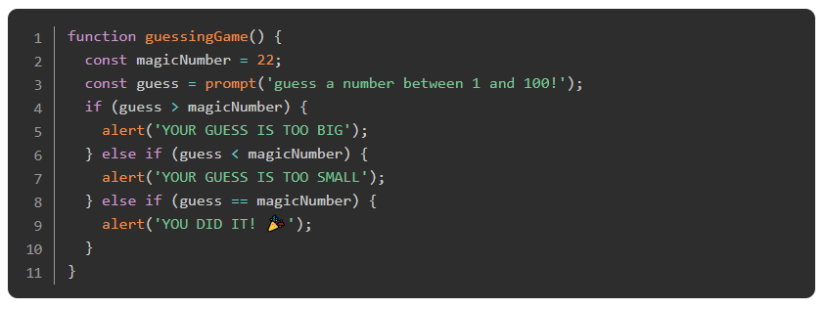
Pure Functions
There are many benefits to using TDD when you write your code. One of the biggest benefits is less obvious at first - it helps you to write better code. If you look back at some of your early projects you will probably notice how tightly coupled everything is. All of your functions include references to functions in other parts of your code, and the whole thing is filled with DOM methods or console.log().
Tightly coupled code is hard to test! Imagine trying to write tests for a function like this:

Slide 20
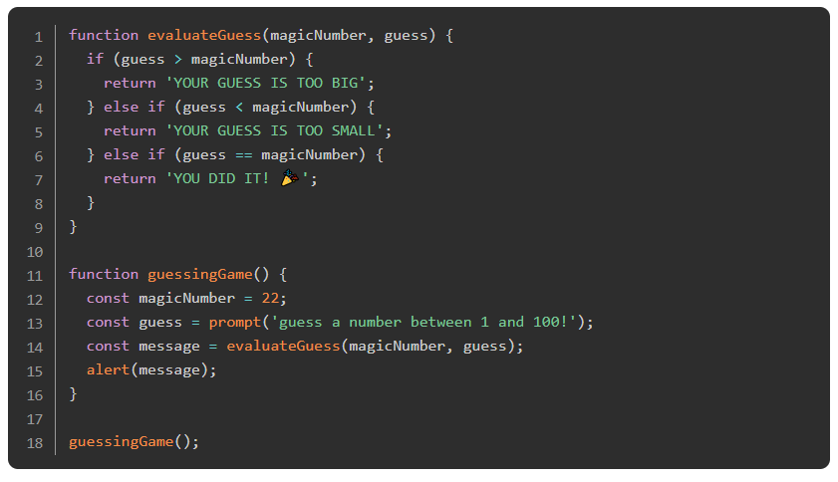
Pure Functions
Making this testable requires us to split up all the different things that are happening. First, we do not need to test the functions prompt and alert because they are built in to the browser. They are external to our program and whoever wrote them has already tested them. What we do need to test is the number logic, which is much easier if we untangle it from the other functions:

Slide 21
Pure Functions
In this example, the only thing we really need to test is the evaluateGuess function, which is much easier to test because it has a clear input and output and doesn’t call any external functions. This implementation is much nicer as well because it’s much easier to extend. If we wanted to switch out the prompt and alerts for methods that manipulate the DOM we can do that more simply now and if we want to make our game more advanced by letting the user make multiple guesses, that is also easier.
If we had written this program with TDD it is very likely that it would have looked more like the second example to begin with. Test driven development encourages better program architecture because it encourages you to write Pure Functions.

Slide 22
Read
Read this quick article about the value of ‘Pure Functions’.
Notes:
🍐 This is a Pear Deck Web Slide.
🍐 To edit the type of question, go back to the "Ask Students a Question" in the Pear Deck sidebar.

Slide 23
Mocking
There are two solutions to the ‘tightly coupled code’ problem. The first, and best option is to simply remove those dependencies from your code as we did above, but that is simply not always possible. The second option is mocking - writing “fake” versions of a function that always behaves exactly how you want. For example, if you’re testing a function that gets information from a DOM input, you really don’t want to have to set up a webpage and dynamically insert something into the input just to run your tests. With a mock function, you could just create a fake version of the input-grabbing function that always returns a specific value and use THAT in your test.

Slide 24
Watch
If you haven’t already, watch the ‘mocking’ videos from this series.

Slide 25
Double the reading pleasure
Too much mocking can be a bad thing. It is sometimes necessary, but if you have to set up an elaborate system of mocks to test any bit of your code, that means your code is too tightly coupled. These two articles (one and two) might be a little extreme, but they contain several really good points about program architecture and testing.

Slide 26
Check this out
Now that you have some practice and context for TDD, this section of the Jest docs will probably make good sense to you.

Slide 27
Add
And finally, if you wish, you can add Jest to your webpack setup. Read about that process here.

Slide 28
Knowledge Check

Slide 29
What is tightly coupled code?
Notes:
🍐 This is a Pear Deck Text Slide
🍐 To edit the type of question, go back to the "Ask Students a Question" in the Pear Deck sidebar.

Slide 30
What are the two requirements for a function to be pure?
Notes:
🍐 This is a Pear Deck Text Slide
🍐 To edit the type of question, go back to the "Ask Students a Question" in the Pear Deck sidebar.

Slide 31
What is mocking?
Notes:
🍐 This is a Pear Deck Text Slide
🍐 To edit the type of question, go back to the "Ask Students a Question" in the Pear Deck sidebar.

Slide 32
Challenge Time!

Slide 33
Challenge: Battleship
It’s time to really flex your muscles. Test Driven Development can certainly feel uncomfortable at first, but becomes more natural with practice. We’re going to implement the classic game ‘Battleship’. If you’ve never played it, or need a refresher you can read about it here and you can play an online version here.
Since we’re doing TDD, it’s important that you don’t get overwhelmed. Simply take it one step at a time. Write a test, then make it pass.
We have not yet discussed testing the appearance of a webpage. Doing this requires a separate set of tools, and it is outside the scope of this unit. For this assignment do your best to isolate every bit of application functionality from the actual DOM manipulation bits. You can use mocks to make sure that DOM methods like appendChild are being called, but try your best to keep those things outside of the app logic.

